Slide 1
Data Warehousing and Mining — Module 1.2—
Introduction to Data Mining
*
‹#›
Data Mining: Concepts and Techniques
‹#›

Slide 2
Why Data Mining?
The Explosive Growth of Data: from terabytes to petabytes
Data collection and data availability
Automated data collection tools, database systems, Web, computerized society
Major sources of abundant data
Business: Web, e-commerce, sale transactions, stocks, …
Science: Remote sensing, bioinformatics, scientific simulation, …
Society and everyone: news, digital cameras, YouTube
We are drowning in data, but starving for knowledge!
“Necessity is the mother of invention”—Data mining—Automated analysis of massive data sets
*
Data Mining: Concepts and Techniques
‹#›

Slide 3
Evolution of Sciences
Before 1600, empirical science
1600-1950s, theoretical science
Each discipline has grown a theoretical component. Theoretical models often motivate experiments and generalize our understanding.
1950s-1990s, computational science
Over the last 50 years, most disciplines have grown a third, computational branch (e.g. empirical, theoretical, and computational ecology, or physics, or linguistics.)
Computational Science traditionally meant simulation. It grew out of our inability to find closed-form solutions for complex mathematical models.
1990-now, data science
The flood of data from new scientific instruments and simulations
The ability to economically store and manage petabytes of data online
The Internet and computing Grid that makes all these archives universally accessible
Scientific info. management, acquisition, organization, query, and visualization tasks scale almost linearly with data volumes. Data mining is a major new challenge!
Jim Gray and Alex Szalay, The World Wide Telescope: An Archetype for Online Science, Comm. ACM, 45(11): 50-54, Nov. 2002
*
Data Mining: Concepts and Techniques
‹#›

Slide 4
Evolution of Database Technology
1960s:
Data collection, database creation, IMS and network DBMS
1970s:
Relational data model, relational DBMS implementation
1980s:
RDBMS, advanced data models (extended-relational, OO etc.)
Application-oriented DBMS (spatial, scientific, engineering, etc.)
1990s:
Data mining, data warehousing, multimedia databases, and Web databases
2000s
Stream data management and mining
Data mining and its applications
Web technology (XML, data integration) and global information systems
*
Data Mining: Concepts and Techniques
‹#›

Slide 5
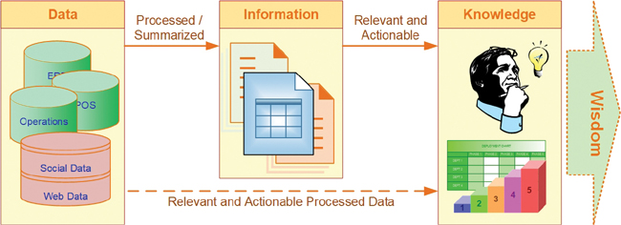
What Is Data Mining?
Data mining is the process of converting data into information and then into knowledge.
Knowledge is very distinct from data and information
Knowledge is information that is contextual, relevant, and actionable.
knowledge has strong experiential and reflective elements that distinguish it from information in a given context.
*
Data Mining: Concepts and Techniques
‹#›

Slide 6
What Is Data Mining?
Data mining is a process that involves using statistical, mathematical, and artificial intelligence techniques and algorithms to extract and identify useful information and subsequent knowledge (or patterns) from large sets of data.
*
‹#›

Slide 7
Fayyad et al. (1996) defined data mining as “the nontrivial process of identifying valid, novel, potentially useful, and ultimately understandable patterns in data stored in structured databases,”
Ø Process implies that data mining comprises many iterative steps.
Ø Nontrivial means that some experimentation-type search or inference is involved;
Ø Valid means that the discovered patterns should hold true on new data with a sufficient degree of certainty.
Ø Novel means that the patterns were not previously known to the user in the context of the system being analyzed.
Ø Potentially useful means that the discovered patterns should lead to some benefit to the user or task.
Ø Ultimately understandable means that the pattern should make business sense that leads to users saying “This makes sense. Why didn’t I think of that?”—if not immediately at least after some processing.
*
‹#›

Slide 8

Data Mining: Alternative names
Alternative names
Knowledge discovery (mining) in databases (KDD),
knowledge extraction,
data/pattern analysis,
data archeology, data dredging,
information harvesting,
business intelligence, etc.
*
‹#›

Slide 9
Knowledge Discovery (KDD) Process
Knowledge
This is a view from typical database systems and data warehousing communities
Data mining plays an essential role in the knowledge discovery process
Pattern Evaluation
Data Mining
Task-relevant Data
Data Warehouse
Selection
Data Cleaning
Data Integration
Databases
*
Data Mining: Concepts and Techniques
‹#›

Slide 10
Data Mining: On What Kinds of Data?
Database-oriented data sets and applications
Relational database, data warehouse, transactional database
Advanced data sets and advanced applications
Data streams and sensor data
Time-series data, temporal data, sequence data
Structure data, graphs, social networks and multi-linked data
Object-relational databases
Spatial data
Multimedia database
Text databases
The World-Wide Web
*
Data Mining: Concepts and Techniques
‹#›

Slide 11
What Kinds of Patterns Can Be Mined?
Data mining functionalities are used to specify the kinds of patterns to be found in data mining tasks.
Descriptive mining tasks : Deals with the General characteristics and converts them into relevant and useful information
Predictive mining tasks: Predicts future values by analyzing data patterns and their outcomes based on past data.
*
Data Mining: Concepts and Techniques
‹#›

Slide 12
Descriptive DM Functionalities
Class/Concept Description:
Data entries can be associated with the classes or concepts.
These descriptions can be derived using
(1) data characterization, by summarizing the data of the class under study (often called the target class) in general terms,
Example: At electronic store a Customer relationship manager asks to Summarize the characteristics of customers who spend more than Rs.10000 a year at the store.
or
(2) data discrimination, by comparison of the target class with one or a set of
comparative classes (often called the contrasting classes),
Example: A customer relationship manager at Electronics store may want to
compare two groups of customers—those who shop for computer products regularly (e.g., more than twice a month) and those who rarely shop for such products (e.g. less than three times a year).
or
(3) both data characterization and discrimination.
*
‹#›

Slide 13
Descriptive DM Functionalities
2. Mining of frequent patterns:
Patterns that occur frequently in data.
It includes--
Frequent itemset : refers to a set of items that often appear together in a transactional data set
Frequent subsequences (also known as sequential patterns): A frequently occurring subsequence like laptop🡪digital camera🡪 memory card
Frequent substructures:
A substructure can refer to different structural forms (e.g., graphs, trees, or lattices) that may be combined with itemsets or subsequences.
If a substructure occurs frequently, it is called a (frequent) structured pattern.
Mining frequent patterns leads to the discovery of interesting associations and correlations within data.
*
‹#›

Slide 14
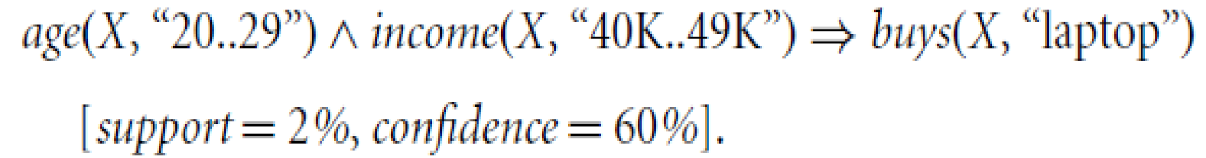
Descriptive DM Functionalities
3. Association Analysis
Defines relationships between the data and predefined association rules.
Suppose that, as a marketing manager at Electronics store, you want to know which items are frequently purchased together
A rule, mined from the Electronics store transactional database
Association rules that contain a single predicate are referred to as single-dimensional association rules.
Suppose, instead, that we are given the Electronics relational database related to purchases. A data mining system may find association rules like
Association rules that contain a more than one predicate/attributes are referred to as multi-dimensional association rules.
*
Data Mining: Concepts and Techniques
‹#›

Slide 15
Descriptive DM Functionalities
4. Clustering : can be used to generate class labels for a group of data. The objects are clustered or grouped based on the principle of maximizing the intraclass similarity and minimizing the interclass similarity.
i.e. clusters of objects are formed so that objects within a cluster have high similarity , but are rather dissimilar to objects in other clusters.
Clustering can also facilitate taxonomy formation 🡪 Organization of observations into a hierarchy of classes that group similar events together.
Example: Cluster analysis can be performed on Electronics store customer data to identify homogeneous subpopulations of customers. These clusters may represent individual target groups for marketing
*
Data Mining: Concepts and Techniques
‹#›

Slide 16
Predictive Data mining functionalities
Predicts future values by analyzing data patterns and their outcomes based on past data.
Classification
Regression
Outlier analysis
*
Data Mining: Concepts and Techniques
‹#›

Slide 17
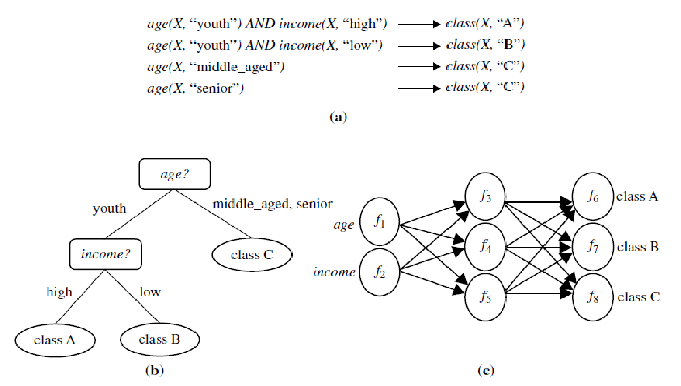
Predictive Data mining functionalities
Classification: is the process of finding a model (or function) that describes and distinguishes data classes or concepts.
The models are derived based on the analysis of a set of training data (i.e., data objects for which the class labels are known).
The model is used to predict the class label of objects for which the class label is unknown.
The derived model may be represented in various forms, such as classification rules (i.e., IF-THEN rules), decision trees, mathematical formulae, or neural networks
*
Data Mining: Concepts and Techniques
‹#›

Slide 18
Predictive Data mining functionalities
2. Regression:
Whereas classification predicts categorical (discrete, unordered) labels, regression models continuous-valued functions. That is, regression is used to predict missing or unavailable numerical data values rather than (discrete) class labels.
The term prediction refers to both numeric prediction and class label prediction.
Regression analysis is a statistical methodology that is most often used for numeric prediction.
Regression also encompasses the identification of distribution trends based on the available data.
*
Data Mining: Concepts and Techniques
‹#›

Slide 19
Predictive Data mining functionalities
3. Outlier Analysis :
Outlier: A data object that does not comply with the general behavior of the data
Many data mining methods discard outliers as noise or exceptions. However, in some applications (e.g., fraud detection), the rare events can be more interesting than the more regularly occurring ones.
Outliers may be detected using statistical tests that assume a distribution or probability model for the data, or using distance measures where objects that are remote from any other cluster are considered outliers.
Example: Outlier analysis may uncover fraudulent usage of credit cards by detecting purchases of unusually large amounts for a given account number in comparison to regular charges incurred by the same account.
Outlier values may also be detected with respect to the locations and types of purchase, or the purchase frequency.
It is used in observing the change in trends of buying patterns of a customer.
*
‹#›

Slide 20
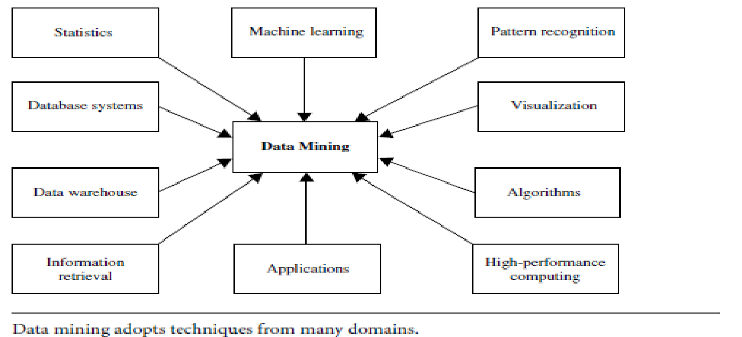
Technologies used in Data Mining
1. Statistics:
It uses the mathematical analysis to express representations, model and summarize empirical data or real world observations.
Statistical analysis involves the collection of methods, applicable to large amount of data to conclude and report the trend.

Slide 21
Technologies used in Data Mining
2. Machine learning
Arthur Samuel defined machine learning as a field of study that gives computers the ability to learn without being programmed.
When the new data is entered in the computer, algorithms help the data to grow or change due to machine learning.
In machine learning, an algorithm is constructed to predict the data from the available database (Predictive analysis).
It is related to computational statistics.

Slide 22
Technologies used in Data Mining
The four types of machine learning are: 1. Supervised learning
It is based on the classification.
It is also called as inductive learning. In this method, the desired outputs are included in the training dataset.
2. Unsupervised learning Unsupervised learning is based on clustering. Clusters are formed on the basis of similarity measures and desired outputs are not included in the training dataset.
3. Semi-supervised learning Semi-supervised learning includes some desired outputs to the training dataset to generate the appropriate functions. This method generally avoids the large number of labeled examples (i.e. desired outputs) .
4. Active learning
Active learning is a powerful approach in analyzing the data efficiently.
The algorithm is designed in such a way that, the desired output should be decided by the algorithm itself (the user plays important role in this type).

Slide 23
Technologies used in Data Mining
3. Database systems and data warehouses
Databases are used for the purpose of recording the data as well as data warehousing.
Online Transactional Processing (OLTP) uses databases for day to day transaction purpose.
To remove the redundant data and save the storage space, data is normalized and stored in the form of tables.
Entity-Relational modeling techniques are used for relational database management system design.
Data warehouses are used to store historical data which helps to take strategical decision for business.
It is used for online analytical processing (OALP), which helps to analyze the data.

Slide 24
Technologies used in Data Mining
4. Information retrieval
Information deals with uncertain representations of the semantics of objects (text, images). For example: Finding relevant information from a large document.

Slide 25
Technologies used in Data Mining
5. Decision support system
Decision support system is a category of information system. It is very useful in decision making for organizations.
It is an interactive software based system which helps decision makers to extract useful information from the data, documents to make the decision.

Slide 26
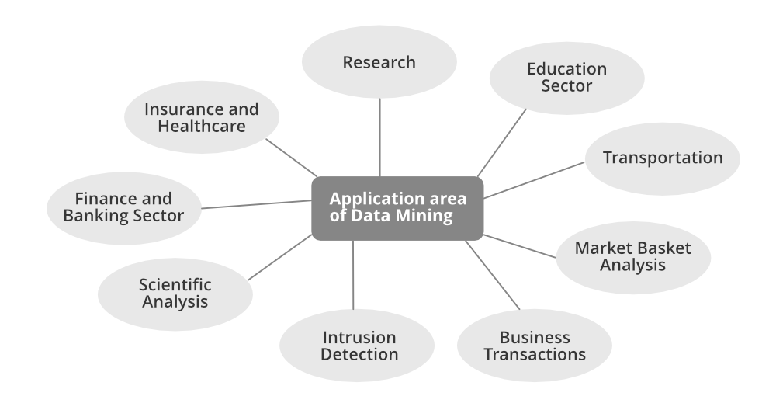
Data Mining: Applications
*
Data Mining: Concepts and Techniques
‹#›

Slide 27
Data Mining: Applications
Marketing and CRM:
-To identify most likely buyers of new products
-To identify root causes of customer attrition so as to improve customer retention
-To discover time variant associations between products and services to maximize sale and find most profitable customers.
Banking and Finance:
-To detect fraudulent credit card and online banking transactions
-To optimize the cash return by forecasting cash flow on banking entities
-To streamline and automate the processing of loan applications by accurately predicting most probable defaulters.
-To maximize the customer value by identifying and selling the products and services that customers are most likely to buy.
Retailing and Logistics:
-To identify accurate sales volume at specific retail locations in order to determine correct inventory levels.
-To do MBA to improve store layout and optimize sales promotions
-To forecast consumption levels for different product types.
-To discover interesting patterns in the movement of products in a supply chain by analyzing sensory and RFID data.
*
‹#›

Slide 28
Data Mining: Applications
Manufacturing:
- To predict machine failures using sensory data
- To discover novel patterns to identify and improve product quality.
5. Brokerages and Security Tradings:
-To predict when and how much certain stock / bond prices will change.
-To forecast range of market fluctuations,direction of fluctuations
-To assess effect of particular issues/events on market movements.
-To identify and prevent fraudulent activities in security trading.
6. Insurance:
- To predict which customers will buy new policies
- Identify fraudulent behavior of customers
- Prevent incorrect claim payments
7. Computer Hardware and Software:
-To predict disk failure
- To identify and filter unwanted web contents and email messages
-To identify potentially unsecured software products
8. Government and Defense:
-To forecast the cost of moving military personnel and equipments.
-To predict resource consumption for better planning and budgeting
*
‹#›

Slide 29
Data Mining: Applications
Travel and Lodging:
- To predict sales of different services to optimally price these services.
- To forecast demand at different locations to better allocate limited organizational resources. .
- To identify most profitable customers and provide them with personalised services.
- To retain valuable employees by identifying and acting on the root causes for attrition
Health and Healthcare:
- To identify successful medical therapies for different illnesses.
- To identify people without health insurance and reasons behind it.
- To forecast the time of demand at different service locations to optimally allocate organizational resources.
- To retain valuable employees by identifying root causes for attrition
Entertainment:
To analyze viewer data to determine which programs to show during prime time.
To decide where to insert advertisements so as to maximize the returns.
To predict financial success of the movies before they are produced.
Sports:
To improve performance of NBA teams in US
To increase the chances of winning.
*
‹#›

Slide 30
Self Learning Topics
1. Data Marts
2. Major issues in Data Mining

Slide 31
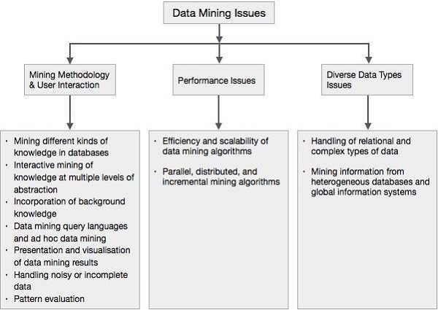
Data Mining Issues

